Slide 1

LLM-FIne Tuned Financial Advisor
Northeastern University
DS5500: Data Science Capstone
P1 Preliminary Presentation
Laasya Anantha Prasad
Krishna Venkatesh
Rakshak Kunchum

Slide 2
Project context
Traditional financial tools may falter with the rapid pace and complexity of personal finances, often resulting in delayed and inaccurate decisions.
Advanced AI, including machine learning and large language models, significantly enhances the speed, accuracy, and adaptability of personal financial management, improving budgeting, investment analysis, and risk assessment.
AI implementation transforms personal finance by providing real-time insights, customizing advice, and automating routine tasks, increasing efficiency and reducing errors.

Slide 3


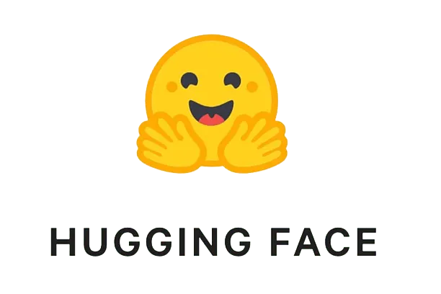
Dataset Sources
Dataset/Text Embeddings/Pretrained models
Historical data of financial news articles and investment blogs scraped using real time Alpaca News API
Alpaca Real Time News API - https://docs.alpaca.markets/docs/streaming-real-time-news
Question Answer Dataset - https://huggingface.co/datasets/gbharti/finance-alpaca

Slide 4
Dataset Description
Question/Instruction | What are the reasons to get more than one credit card? | Investing in real estate when the stock market is high, investing in stocks when it's low?
Output/Advice | If you have to replace a card due to damage, loss, or identity theft it's nice to have a backup you can use until the new card for your primary account arrives. I know folks who use a secondary card for online purchases specifically so they can kill it if necessary without impacting their other uses, online arguably being at more risk. If there's no yearly fee, and if you're already paying the bill in full every month, a second card/account is mostly harmless. If you have trouble restraining yourself with one card, a second could be dangerous. | The right time to buy real estate is easy to spot. It's the wrong time to buy when houses are sold within hours of the sign going up. The way to profit from equities over time is to dollar-cost average a diversified portfolio over time, while keeping cash reserves of 5-15% around. When major corrections strike, buy a little extra. You can make money at trading. But it requires that you exert a consistent effort and stay up to date on your investments and future prospects.

Slide 5
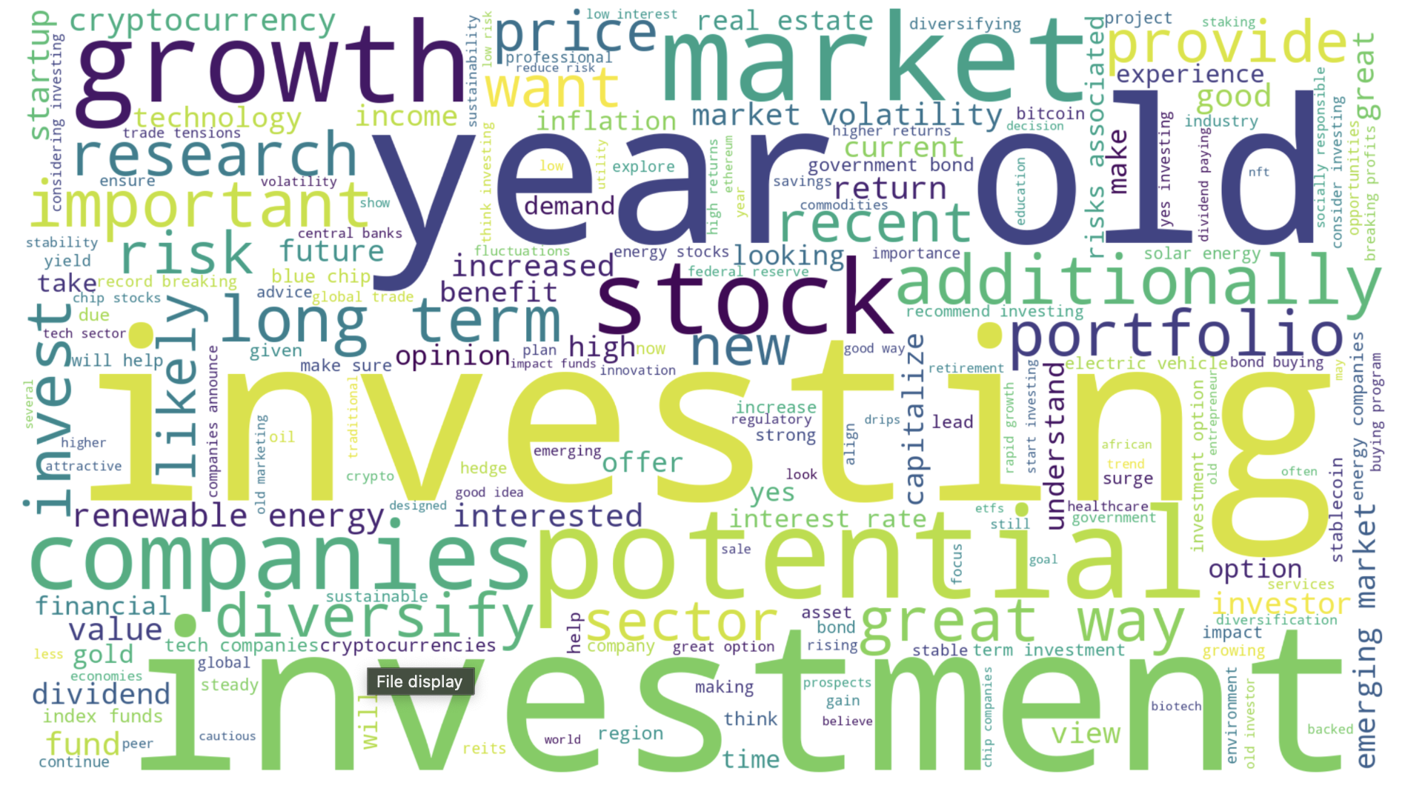
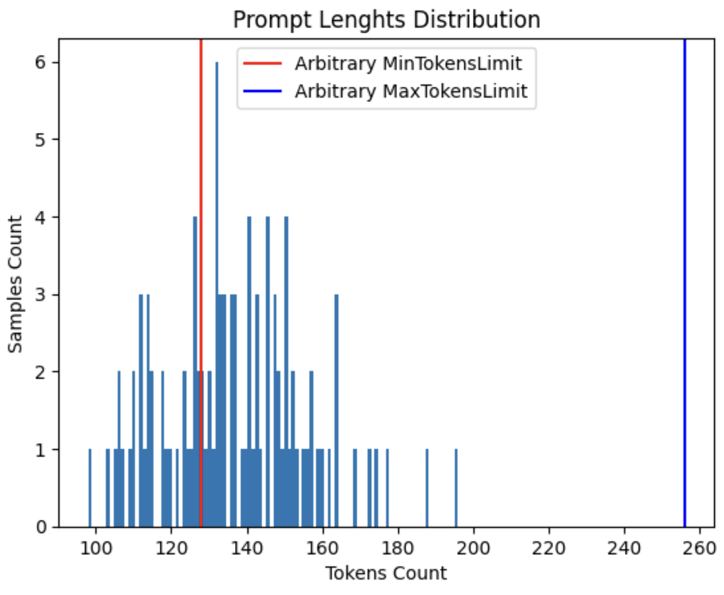
Preliminary results - EDA
Figure 1: Word Cloud
Figure 2: Prompt length for deciding context window for LLMs

Slide 6
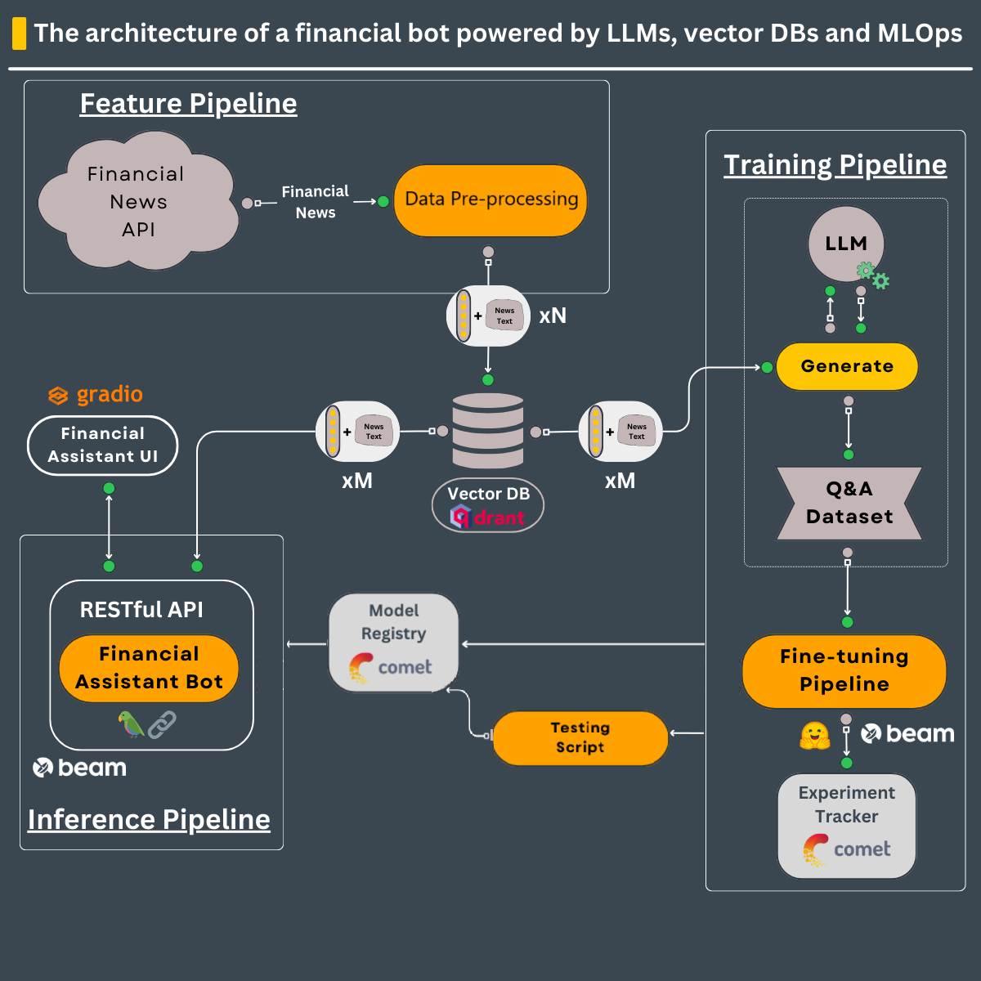
MEthodology
Feature Pipeline:
Financial news data is processed through a streaming pipeline and stored in a Vector DB (Qdrant).
Training Pipeline:
A pre-trained LLM generates a Q&A dataset from the news data for fine-tuning.
Model Fine-tuning and MLOps:
LoRA weights adjust the model parameters, with tracking done by Comet.
Inference Pipeline:
The fine-tuned model is deployed via a RESTful API and Gradio for user to interact and get advice.

Slide 7



Approaches: Leveraging LLMs
Large Language Models
We deploy large language models (LLMs) fine-tuned on financial datasets, enhancing their ability to interpret complex financial texts and respond to sector-specific queries accurately.
Potential LLMs to be explored:
BLING 1B
Llama 3.2 3B
Falcon-7B
PEFT/QLoRA
QLoRA modifies a minimal set of model parameters, allowing for rapid adaptation to financial contexts. This method improves model responsiveness and accuracy without the extensive computational demands of full retraining.
Retrieval Augmented Generation
RAG incorporates a retrieval system that fetches relevant financial data during response generation, greatly enhancing output accuracy and relevance. This integration reduces errors and ensures responses are contextually rich and reliable.

Slide 8
Deliverables and Timeline
Phase | Weeks | Activities | Goals
Data Preparation | 1-3 | Data collection, cleaning, embedding, and exploratory analysis. | Finalize data cleaning and ensure datasets are ready for training, stored in Vector Database (Qdrant).
Model Fine-Tuning | 4-6 | Fine-tune the LLM with LoRA, track model performance using Comet. | Ensure fine-tuning achieves performance benchmarks on financial text tasks.
Model Evaluation | 7-8 | Evaluate model, refine performance metrics. | Model integrates with Qdrant, pulling accurate data in real-time, minimizing errors.
System Integration | 9-10 | Integrate RAG for real-time data retrieval, begin system testing. | RAG operates seamlessly, accurately retrieves and integrates real-time data.
API Development | 11-12 | Develop and test API for the financial assistant bot. | API functions correctly, facilitating efficient user interaction with the model.

Slide 9
Risks
Data Sensitivity and Regulatory Compliance:
Risk: High sensitivity of personal financial data requires strict adherence to privacy regulations.
Mitigation: Use strong data protection protocols and continuously monitor compliance to safeguard personal data and adhere to financial laws.
Security and Accuracy Enhancements:
Risk: Risks of data theft and receiving misleading advice due to biases in personal financial tools.
Mitigation: Enhance security measures, perform frequent financial audits, and correct biases in financial planning tools and advice.
Model Reliability and Ethical Decision-Making:
Risk: Technological errors could lead to financial mismanagement and ethical issues in automated financial decisions.
Mitigation: Incorporate fail-safes in financial management tools, regularly evaluate ethical considerations, and maintain transparency and accountability in financial algorithms.

Slide 10



CONCLUSIONS
Enhanced Decision-Making and Efficiency:
The Financial LLM Advisor automates complex tasks, boosting accuracy and speeding up financial decisions, reducing errors and saving time.
Personalized Financial Guidance for Individuals:
This tool provides personalized financial advice, helping individuals make smarter investment and savings choices, boosting financial empowerment for all.
Scalable and Accessible Financial Services:
Using advanced LLM technology, we make expert financial advice more affordable and accessible, democratizing financial expertise for broader use.

Slide 11
ThanK YoU

